Slide 1
DEEP LEarNiNg MastEr Class
Day-27

Slide 2
01
Project using rnn lstm
Concept

Slide 3
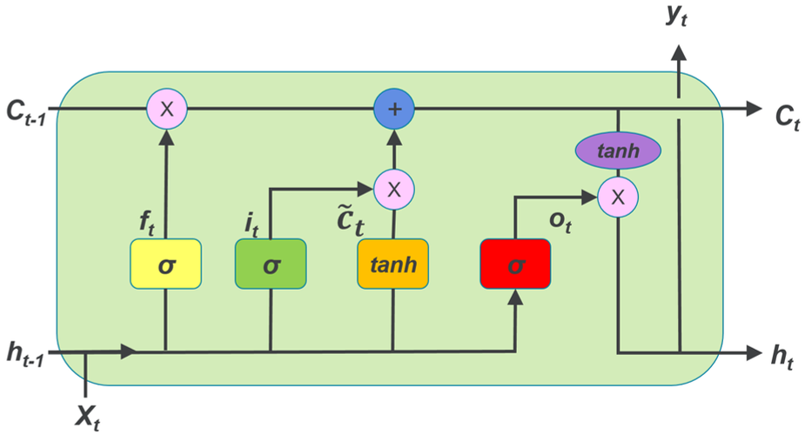
Cell state & Gates
The key to LSTMs is the cell state, the horizontal line running through the top of the diagram
The cell state is kind of like a conveyor belt. It runs straight down the entire chain, with only some minor linear interactions. It’s very easy for information to just flow along with it unchanged.
The LSTM does have the ability to remove or add information to the cell state, carefully regulated by structures called gates.
Gates are a way to optionally let information through. They are composed out of a sigmoid neural net layer and a pointwise multiplication operation.

Slide 4
Cell state & Gates
The sigmoid layer outputs numbers between zero and one, describing how much of each component should be let through. A value of zero means “let nothing through,” while a value of one means “let everything through!”
If you look at the architecture of LSTM you can observe that it has three gates, to protect and control the cell state:
1) Forget Gate.
2) Input Gate.
3) Output Gate.

Slide 5
Recurrent neural network

Slide 6
Step 1 - Decide How Much Past Data It Should Remember
The first step in the LSTM is to decide which information should be omitted from the cell in that particular time step.
The sigmoid function determines this, It looks at the previous state (ht-1) along with the current input xt and computes the function.
Consider the following two sentences:
Let the output of h(t-1) be “Alice is good in Physics. John, on the other hand, is good at Chemistry.”
Let the current input at x(t) be “John plays football well. He told me yesterday over the phone that he had served as the captain of his college football team.”
The forget gate realizes there might be a change in context after encountering the first full stop. It compares with the current input sentence at x(t). The next sentence talks about John, so the information on Alice is deleted. The position of the subject is vacated and assigned to John.

Slide 7
Step 2: Decide How Much This Unit Adds to the Current State
In the second layer, there are two parts. One is the sigmoid function, and the other is the tanh function.
In the sigmoid function, it decides which values to let through (0 or 1). tanh function gives weightage to the values which are passed, deciding their level of importance (-1 to 1).
With the current input at x(t), the input gate analyzes the important information — John plays football, and the fact that he was the captain of his college team is important.
“He told me yesterday over the phone” is less important; hence it's forgotten. This process of adding some new information can be done via the input gate.

Slide 8
Step 3: Decide What Part of the Current Cell State Makes It to the Output
The third step is to decide what the output will be.
First, we run a sigmoid layer, which decides what parts of the cell state make it to the output.
Then, we put the cell state through tanh to push the values to be between -1 and 1 and multiply it by the output of the sigmoid gate.
Let’s consider this example to predict the next word in the sentence: “John played tremendously well against the opponent and won for his team. For his contributions, brave was awarded player of the match.”
There could be many choices for the empty space. The current input brave is an adjective, and adjectives describe a noun. So, “John” could be the best output after brave.

Slide 9
Deep Learning Terminology - 1
AGI (Artificial General Intelligence)
It is an emerging field aiming at the building of “thinking machines”; that is, general-purpose systems with intelligence comparable to that of the human mind, also called “Strong AI”, “Human-level AI”, etc.

Slide 10
Deep Learning Terminology - 2
ANI (Artificial Narrow Intelligence)
A one trick pony, they can play chess, recognize faces, translate foreign languages.

Slide 11
Deep Learning Terminology - 3
ASI (Artificial Super Intelligence)
Smarter than the best human brains and has the ability to apply that to absolutely anything (This is the AI that people like Stephen Hawking, Elon Musk, etc. are scared of).

Slide 12
Quote of the day
Short bytes – D27
Don’t wait until you’ve reached your goal to be proud of yourself
Be Proud of every step you take toward reaching that Goal

Slide 13
Thanks!
Thanks!
Follow Me on LinkedIn : Link in Description
+91 7305845758
Pantechsolutions.net

